Slide 1

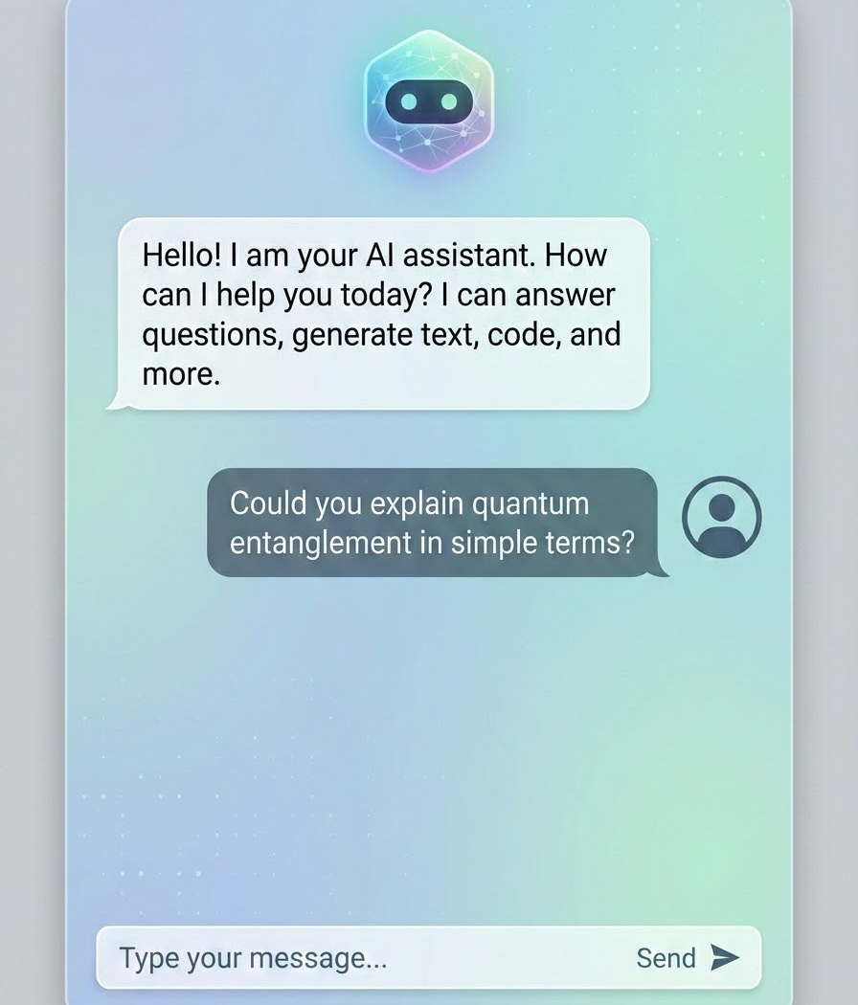
Executive Summary
The Problem
Property search platforms require users to manually browse hundreds of listings and apply multiple restrictive filters.
The Solution
An AI-powered conversational real estate assistant that helps users discover properties using natural language.
The Outcome
Faster property discovery
Personalized recommendations
Conversational search experience
AI-powered decision support
Key Message: Transform tedious filter-based searches into intuitive conversations.

Slide 2




Product Vision
The Vision
Replace traditional property search forms with intelligent conversational AI.
"Find a 2 BHK apartment in Hyderabad under ₹60 Lakhs near IT companies."
Product Goals
Simplify property discovery
Improve user engagement
Reduce search effort
Personalize recommendations

Slide 3




User Experience Flow
A seamless journey from intent to personalized discovery.
User
Chat Interface
AI Understanding
Property Search
Recommendations
Natural Language Input
Instant Recommendations
Saved Properties

Slide 4










Solution Architecture
React Frontend
FastAPI Backend
Groq LLM Layer
Search Engine
MongoDB
Key Message: A modern, decoupled stack designed for speed, scale, and AI integration.

Slide 5


AI Architecture
LLM Selected: Groq + Llama 3.3 70B
AI Responsibilities
Why Selected:
Intent Detection
Query Understanding
Extremely low latency
High inference speed
Preference Extraction
Response Generation
Strong reasoning capabilities
Cost efficient
Production-ready APIs
Key Message: Groq enables real-time conversational experiences without inference lag.

Slide 6






Data Intelligence Layer
Property Basics
Characteristics
Visuals
Price
Bedrooms & Bathrooms
Photos
Location
Amenities
Visual previews
Title
Processing Flow
Multiple Sources
Integration Layer
Unified Model
Search Engine

Slide 7
Engineering Decisions
Technology | Selected Because...
React (Frontend) | Component architecture, fast development cycles, excellent interactive user experience.
FastAPI (Backend) | High performance, native async processing, extremely AI/ML integration friendly.
MongoDB (Database) | Flexible schema for diverse properties, JSON-native storage aligns with API, easy horizontal scaling.
Groq (LLM Inference) | Industry-leading inference speed, significantly lower latency than standard cloud alternatives.
Key Message: Every technical choice was optimized for low-latency conversational AI.

Slide 8
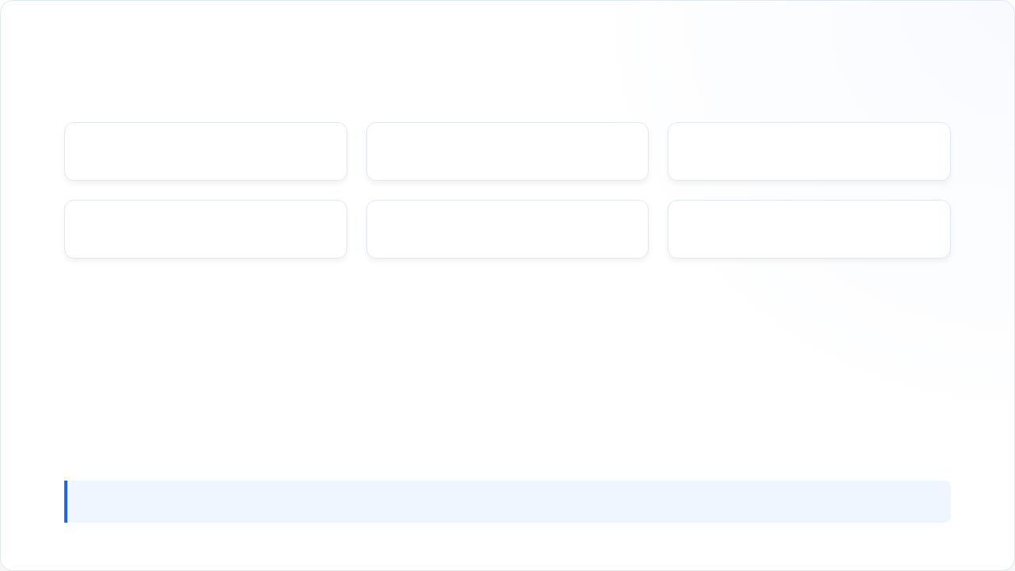






Core Platform Features
Conversational Search
Intelligent Discovery
AI Query Understanding
Dynamic Filtering
Saved Properties
Personalized Experience
Key Message: A feature set designed to mimic a knowledgeable human real estate agent.

Slide 9



Business Impact
User Impact
Faster search process
Reduced decision fatigue
Better, highly relevant recommendations
Executive KPI Dashboard
Improved overall satisfaction
SEARCH TIME
ENGAGEMENT
-40%
+2.5x
Technical Impact
AI-native architecture
LEAD CONVERSION
LATENCY
+15%
<800ms
Modular, maintainable design
Scalable infrastructure
Future-ready platform

Slide 10



Future Roadmap
Future Capabilities
Phase 1
Conversational Property Search
Market Insights: Real-time pricing trends.
Personalized Recommendation Engine
Investment Recommendations: ROI forecasting.
Phase 2
Personalized Alerts: Proactive notifications via AI.
Phase 3
Property Comparison Assistant
Predictive Matching: Anticipating user needs before they ask.
Phase 4
RAG-Powered Search (Real-time docs)
Phase 5
Agentic Real Estate Advisor
Key Message: Evolving from a search tool to a comprehensive, autonomous advisory platform.

Slide 11

Image Sources
https://media.istockphoto.com/id/1199343722/photo/finding-apartment-for-rent-on-internet-real-estate-agency-website-screen-with-fake-map-on.jpg?s=612x612&w=0&k=20&c=iZ95aDqM4p-wJ4J21i9LszxTqE49kEIKnF9kX_z5VzI=
Source: www.istockphoto.com
https://media.istockphoto.com/id/1283590509/vector/real-estate-technology-isometric-landing-page.jpg?s=612x612&w=0&k=20&c=hBvK-j1vG3T1p0D1M2v1yW_wO2mP_F33yU2M2055wLw=
Source: www.istockphoto.com

